Slide 1







BORCELLE
WEB CISC3003
CHE CHI HIN
DC325182
https://cisc3003team01.is-great.net

Slide 2
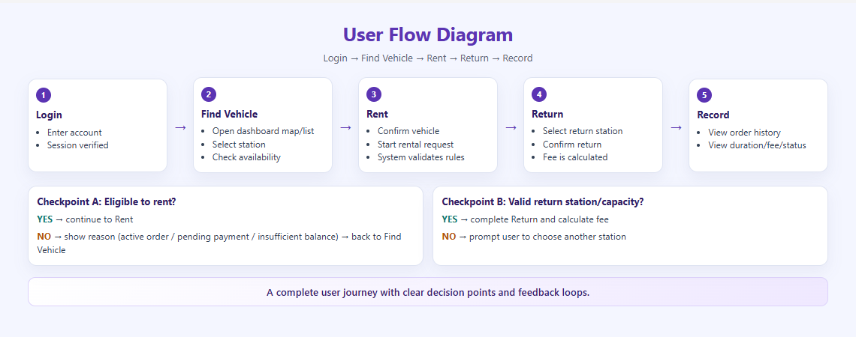
The interface is designed around continuous task completion, not isolated pages.

Slide 3
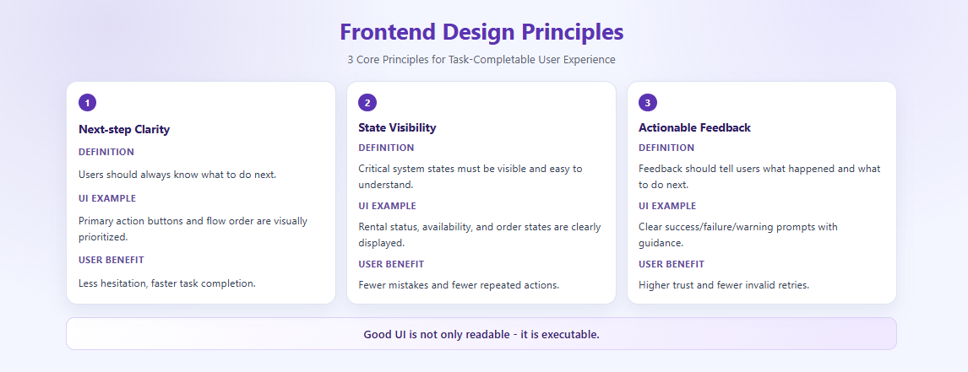
These principles reduce hesitation, errors, and repeated invalid actions.

Slide 4
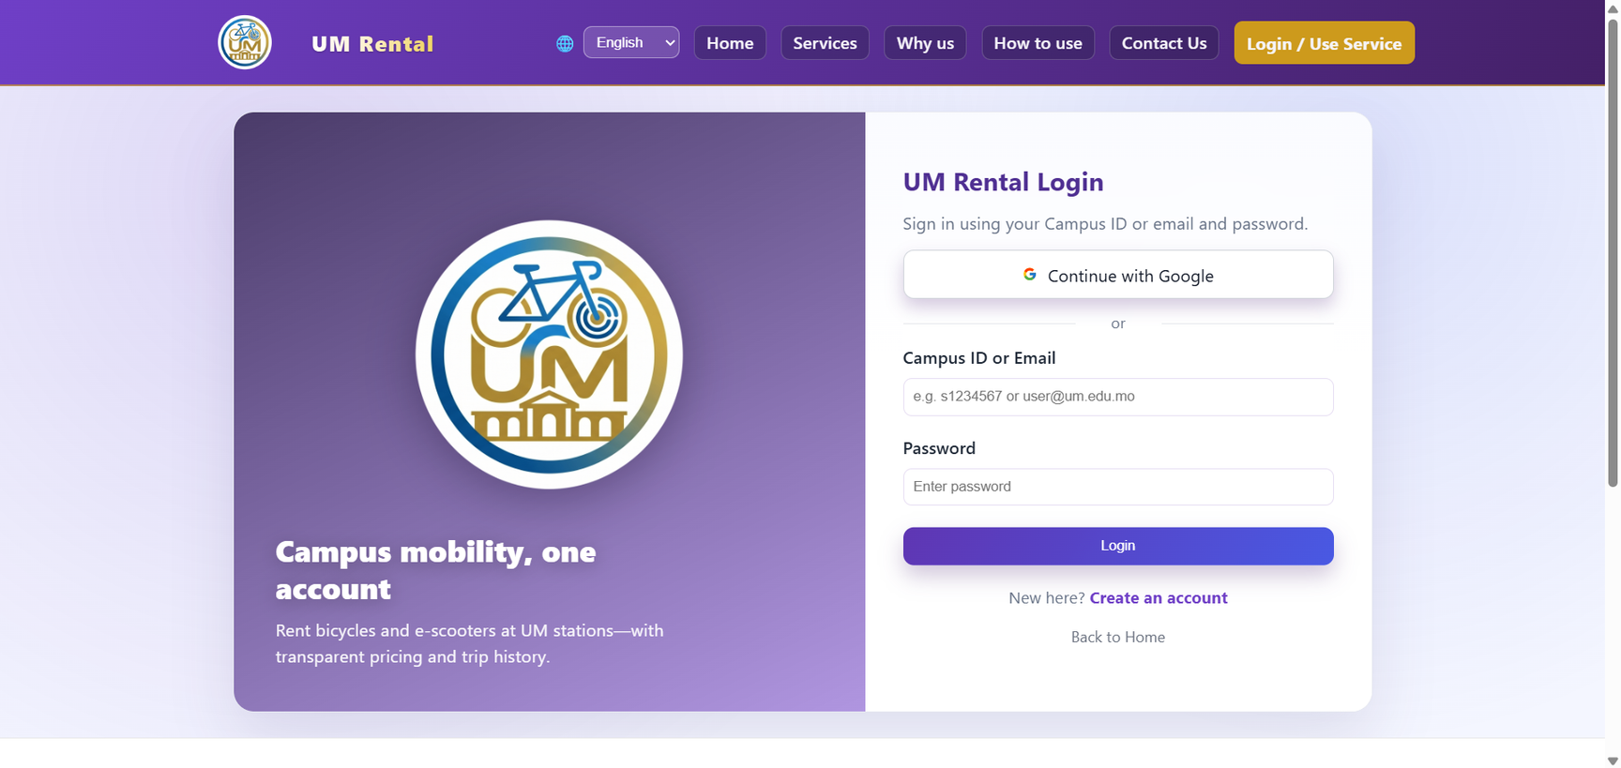
login.php
Users can complete authentication quickly with low cognitive load.

Slide 5
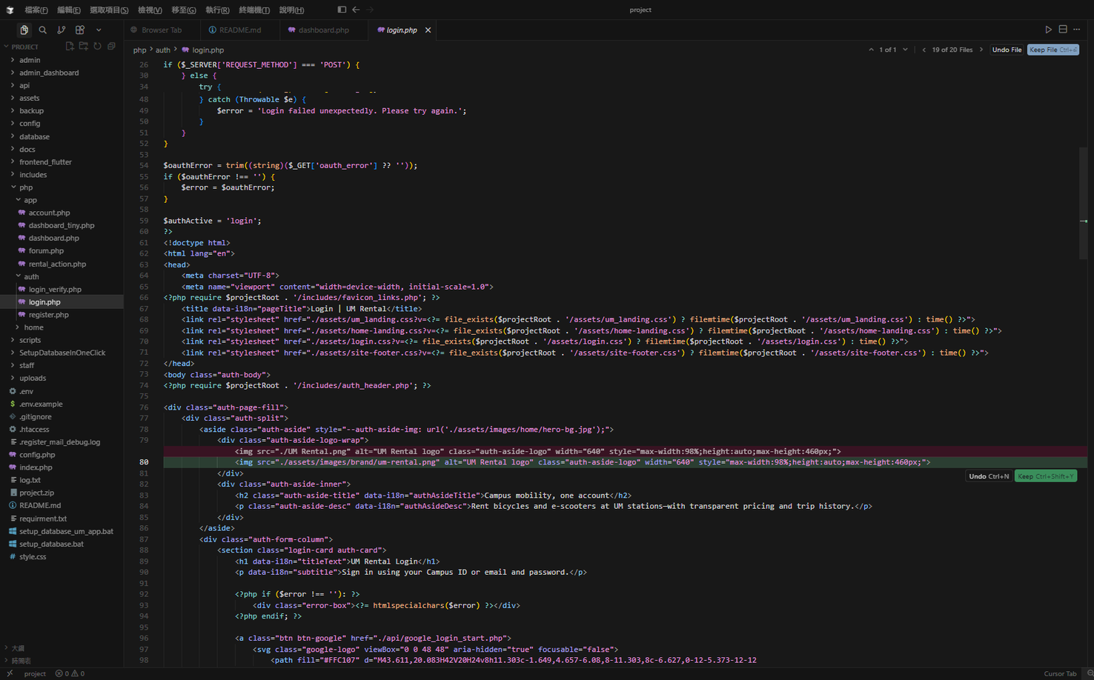
login.php
Key operations remain visible and efficient in a rich information view.

Slide 6
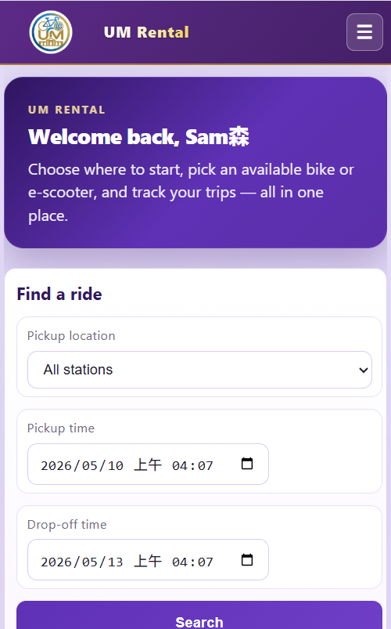
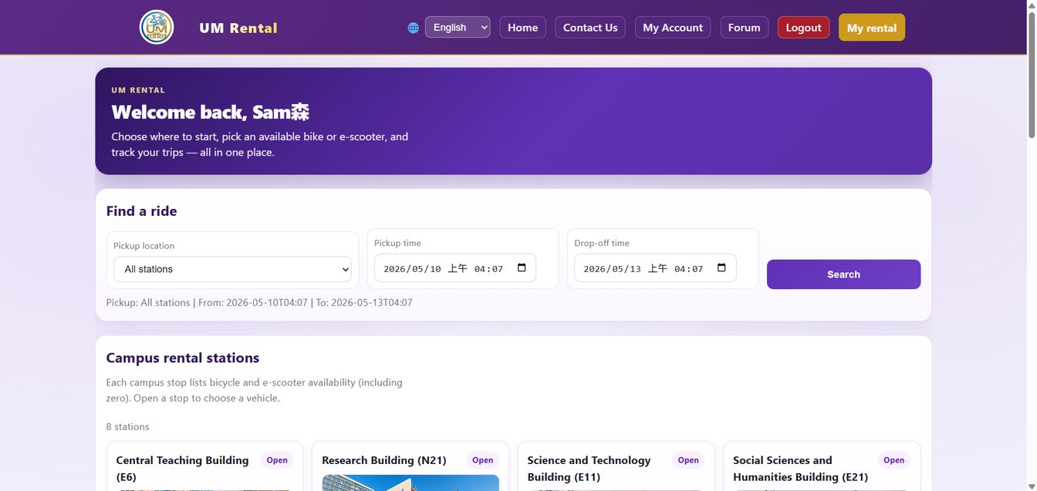
dashboard.php
Critical actions remain reachable on small screens without layout confusion.

Slide 7
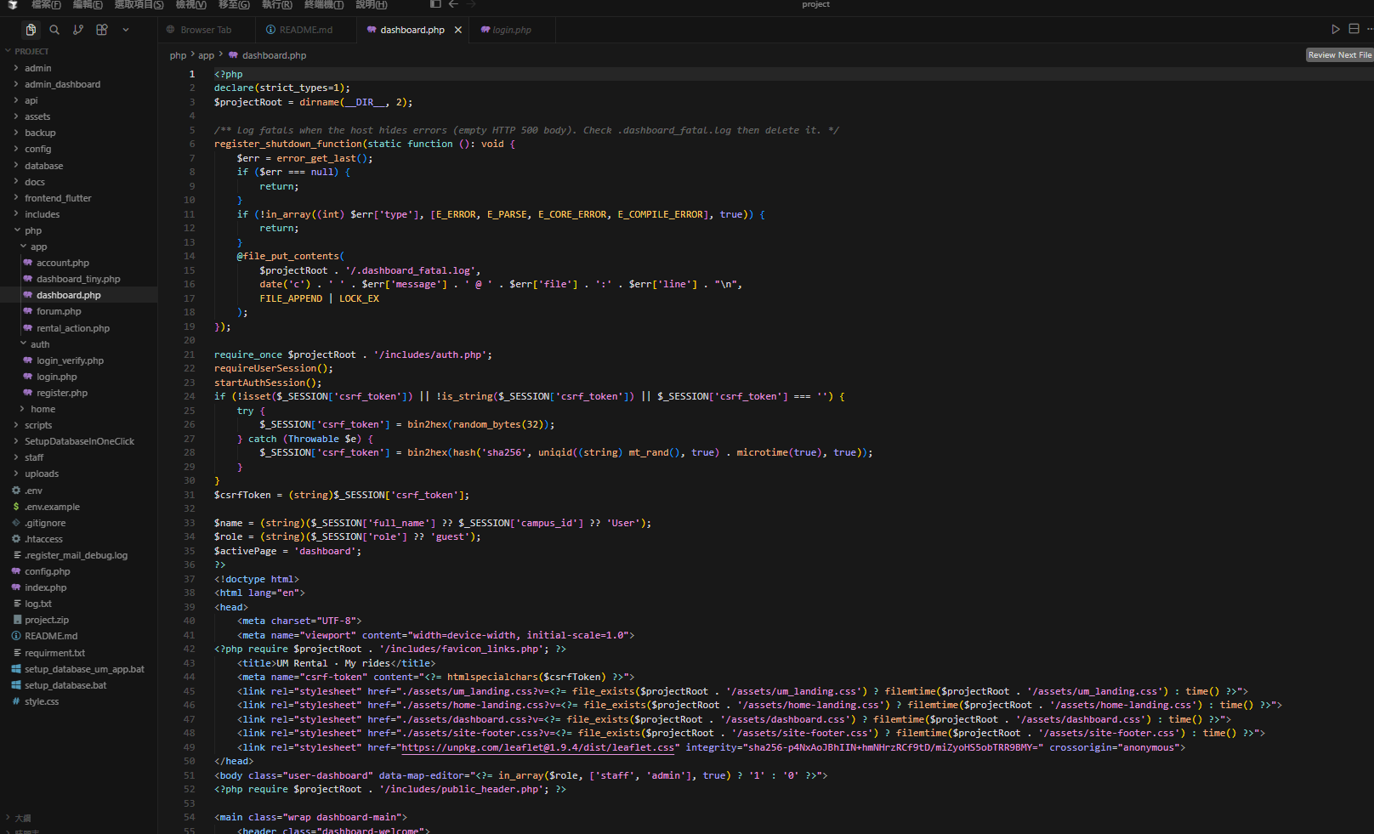
dashboard.php

Slide 8
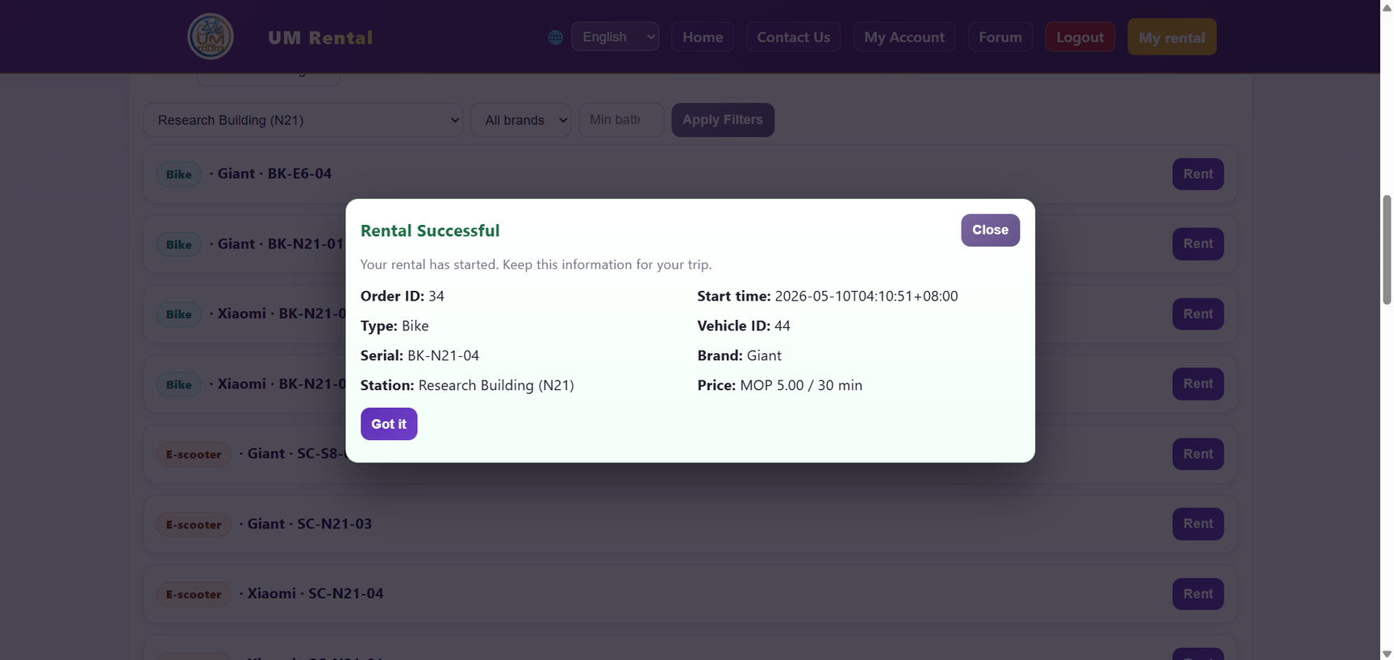
dashboard.php
Consistent feedback improves trust and prevents repeated misoperations.

Slide 9
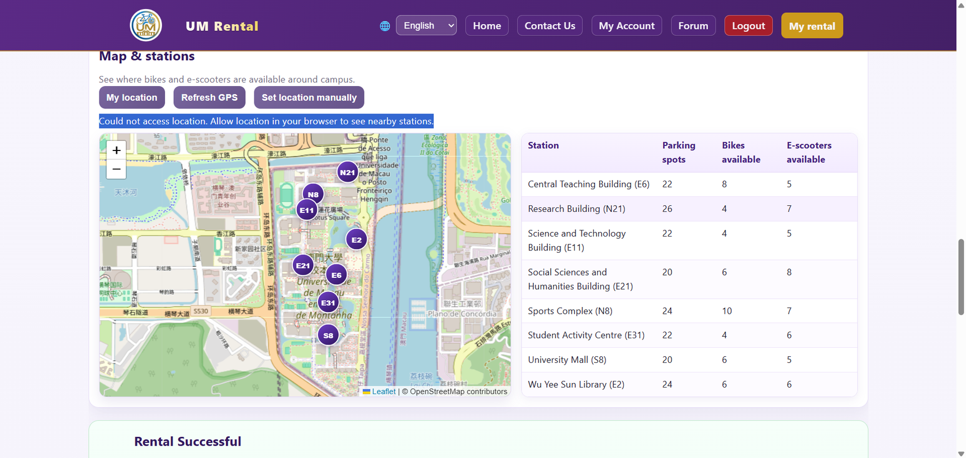
dashboard.php

Slide 10
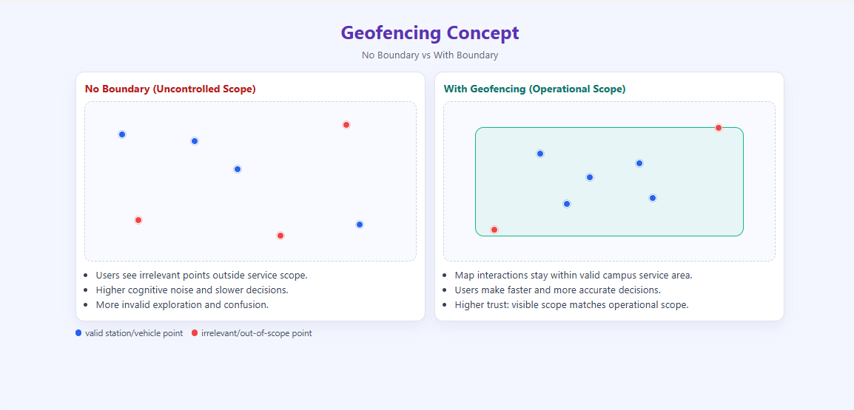

Slide 11
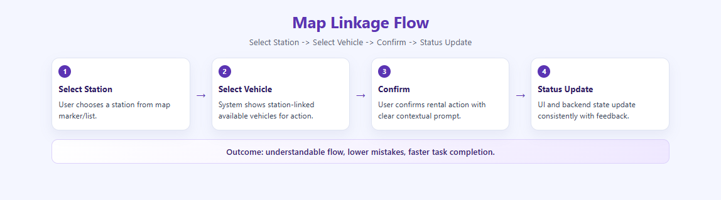

Slide 12
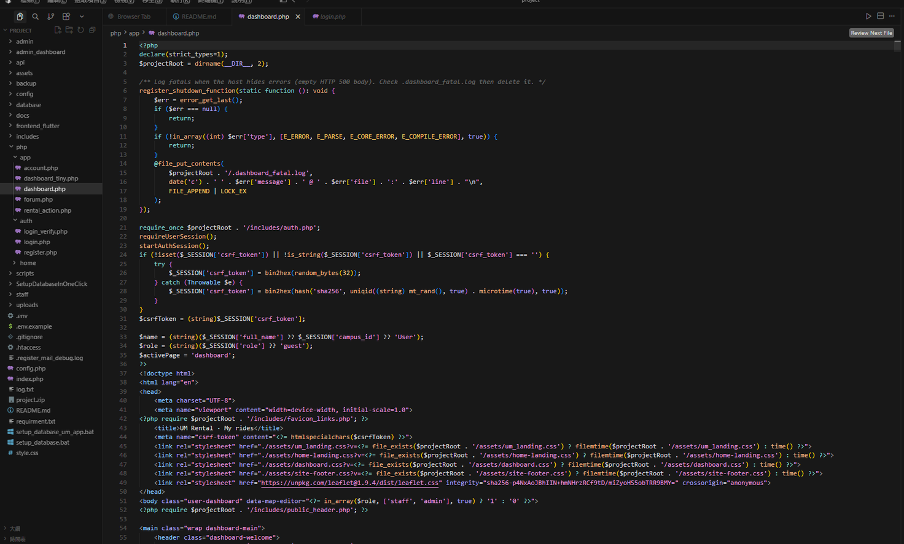
dashboard.php

Slide 13
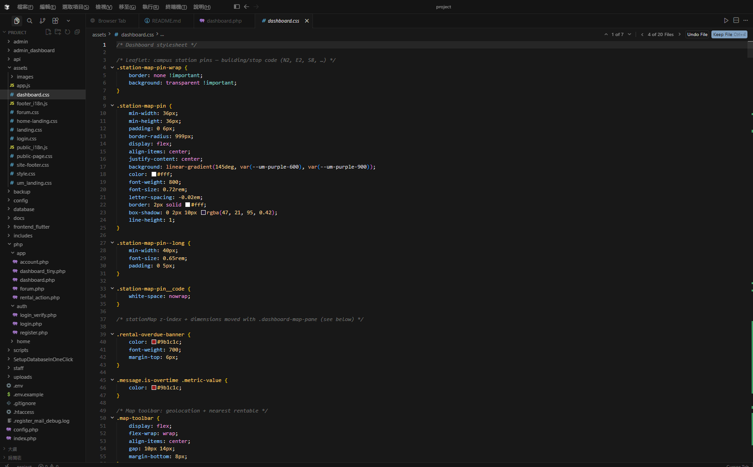
dashboard.css

Slide 14
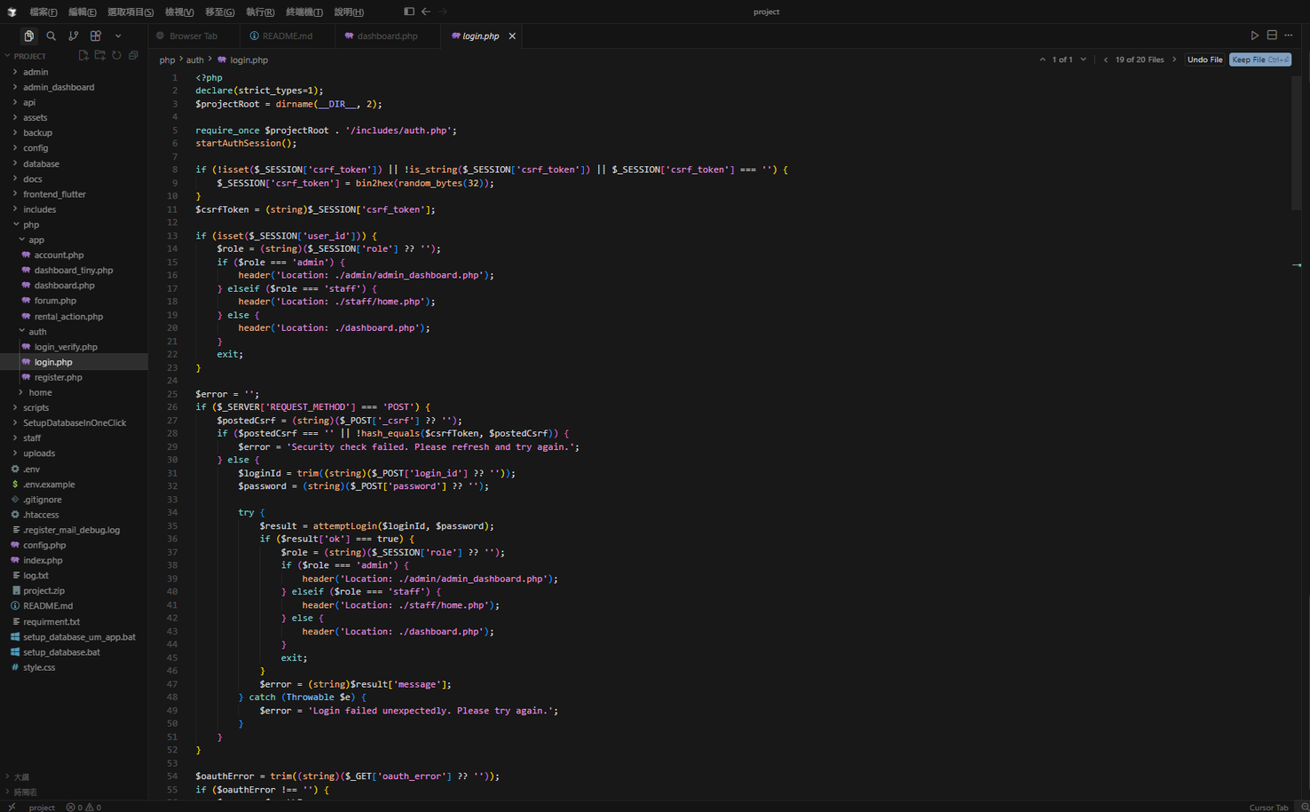
login.php

Slide 15
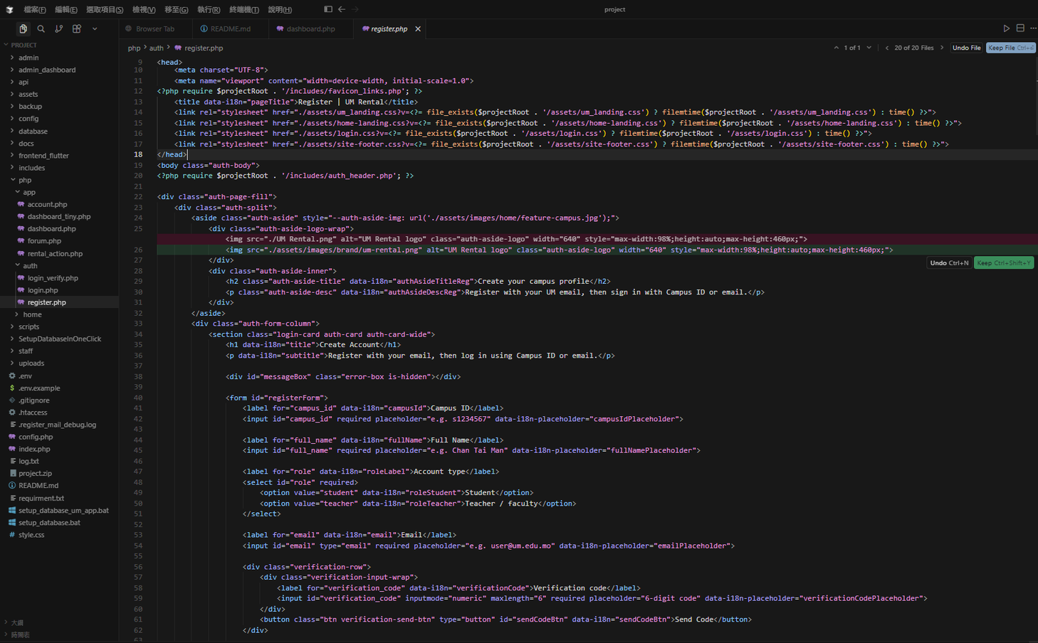
register.php

Slide 16
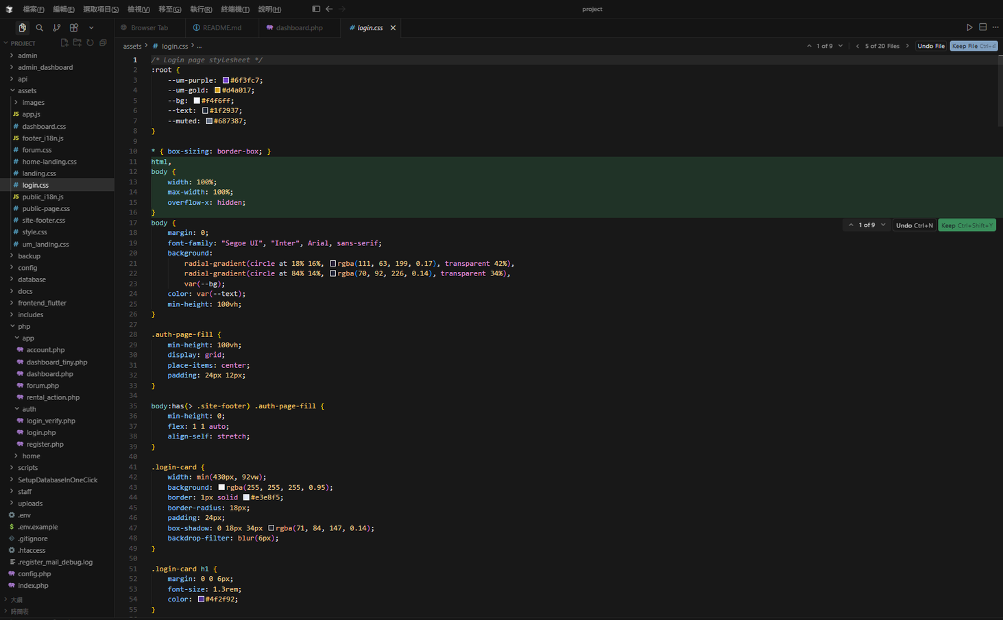
login.css

Slide 17
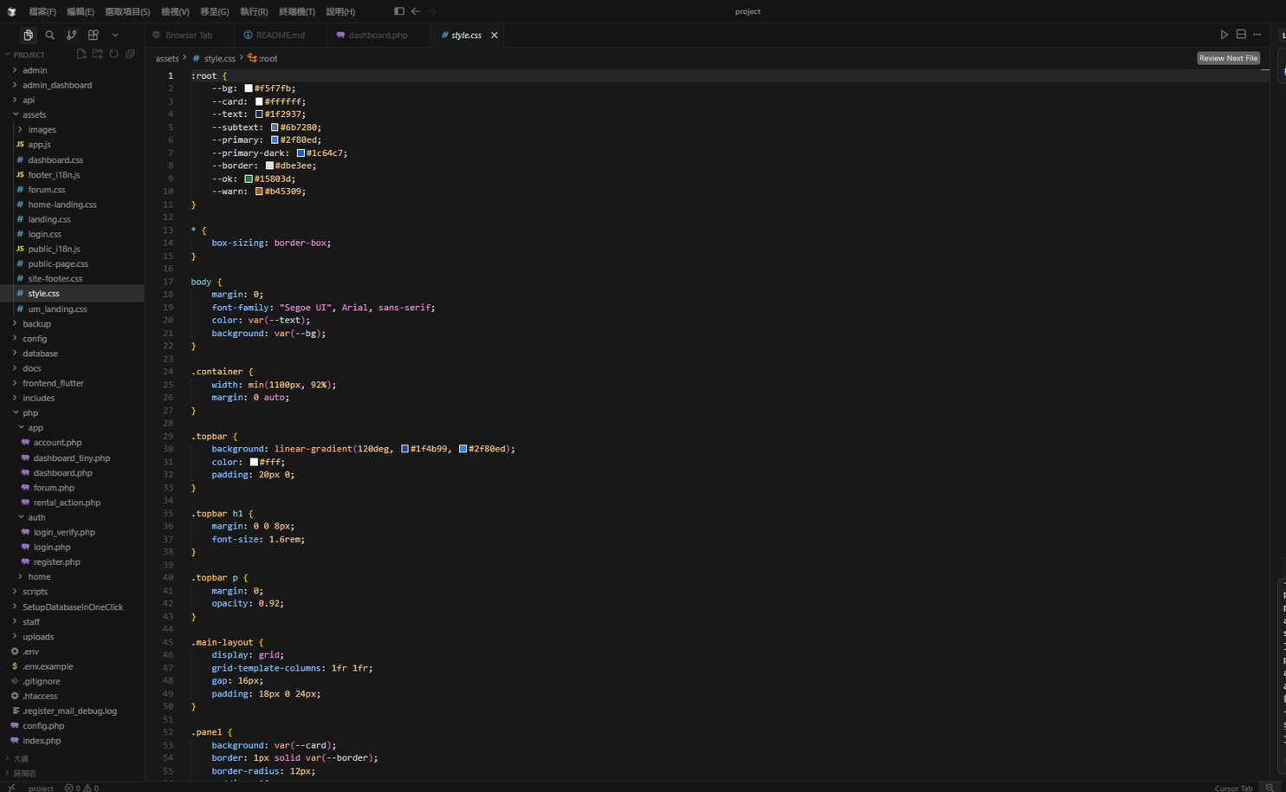
style.css

Slide 18
dashboard.php

Slide 19
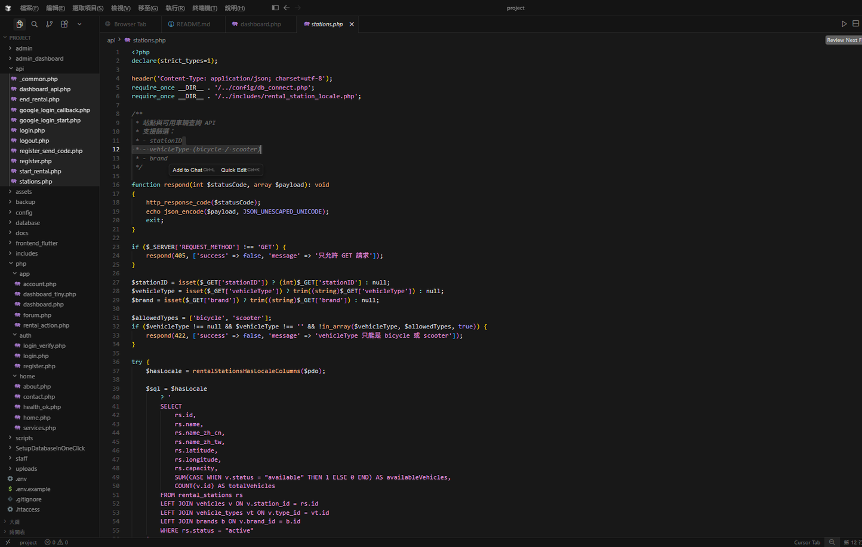
stations.php

Slide 20
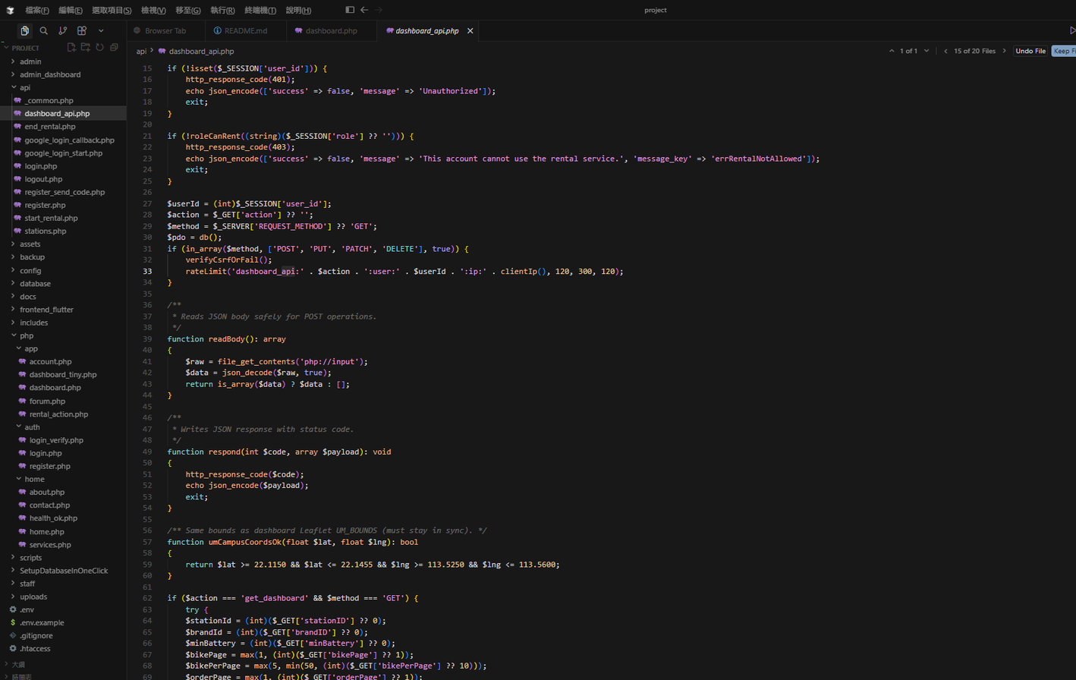
dashboard_api.php

